Slide 1
Predicting Global Video-Game Sales

Slide 2
QUESTIONS
Q1: Are there a different local Sales related to each other in countries?
Q2: What is the highest selling type of video game in global sales and North America?
Q3: Who are the most popular publishers?
Q4: Which is the most popular Platform in Global Sales?
Q5: who are the highest sales?

Slide 3
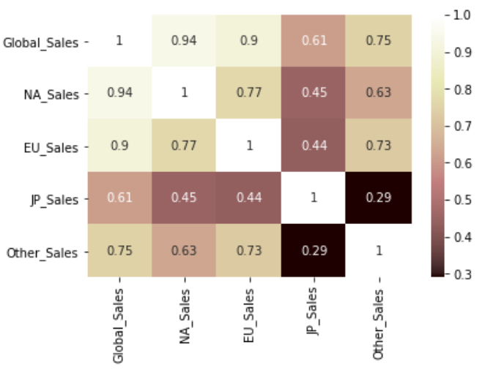
The Answer to the Q1
Q1: Are there a different local Sales related to each other in countries?

Slide 4
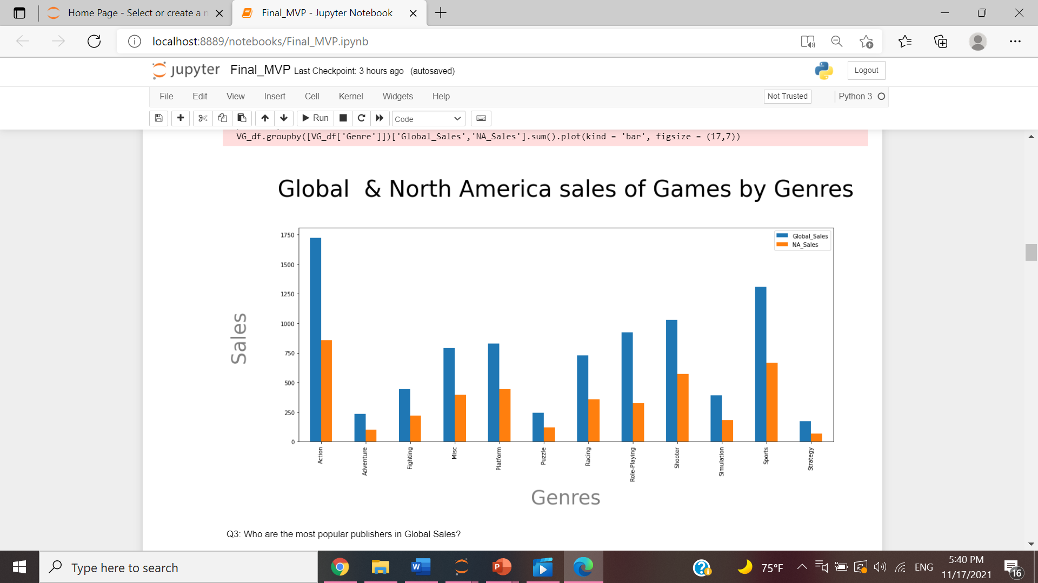
The Answer to the Q2
Q2: What is the highest selling type of video game in global sales

Slide 5
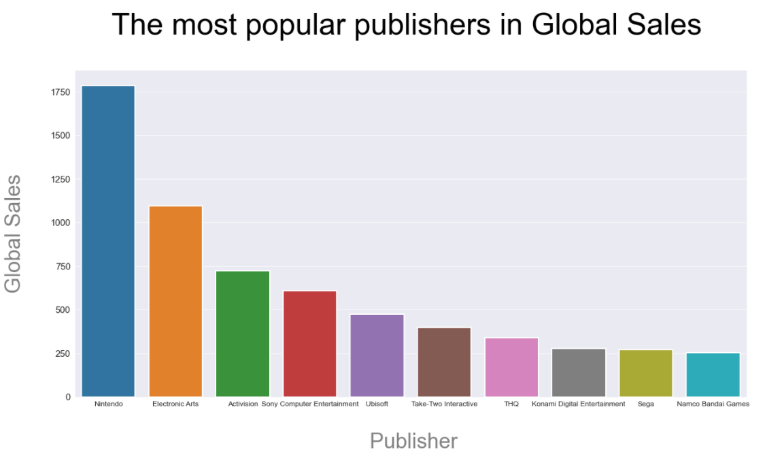
The Answer to the Q3
Q3: Who are the most popular publishers?

Slide 6
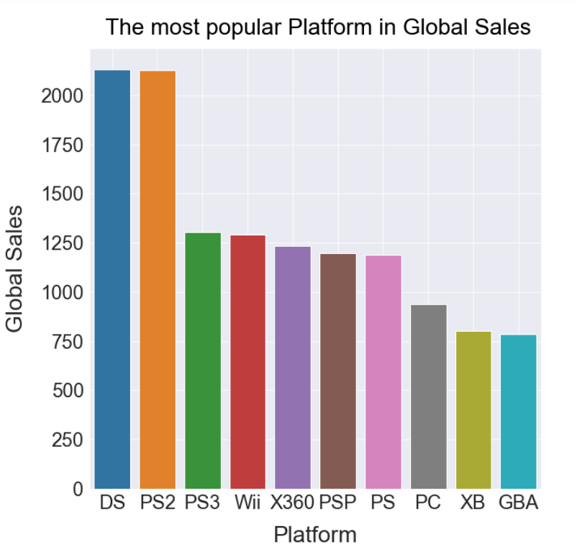
The Answer to the Q4
Q4: Which is the most popular Platform in Global Sales?

Slide 7
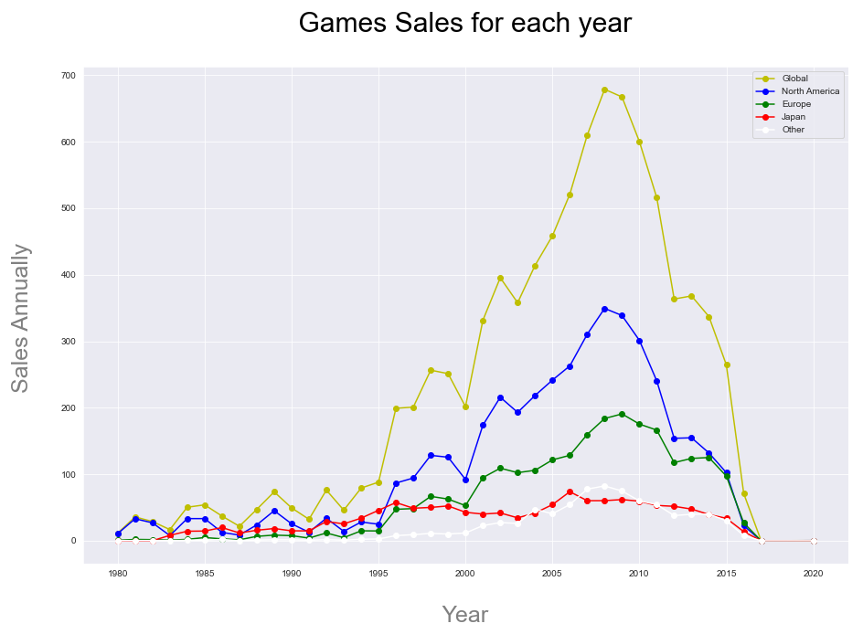
The Answer to the Q5
Q5: who are the highest sales?

Slide 8
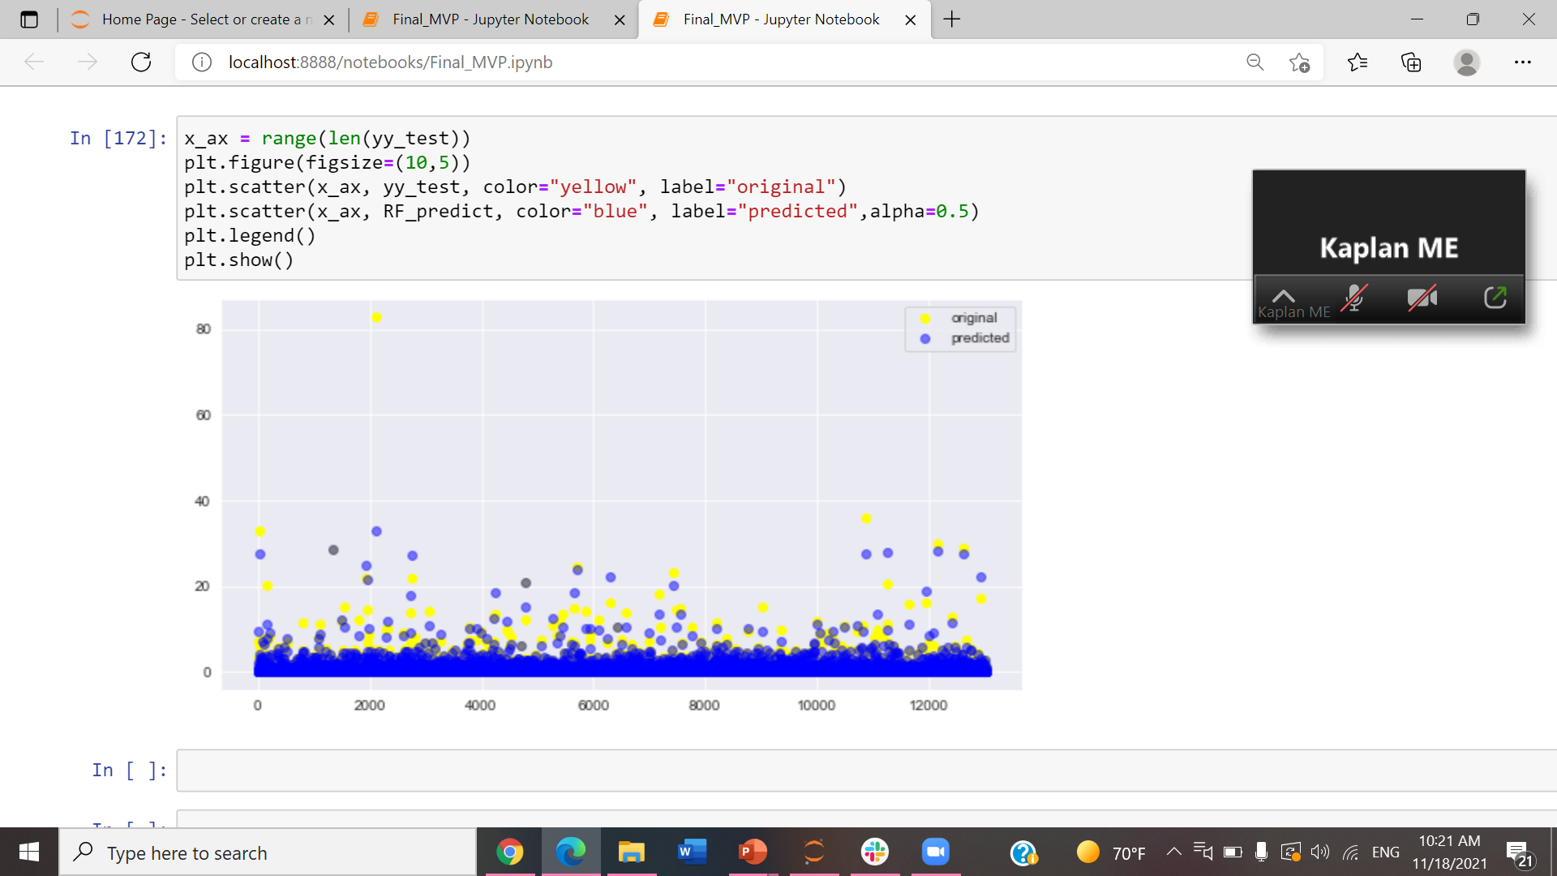
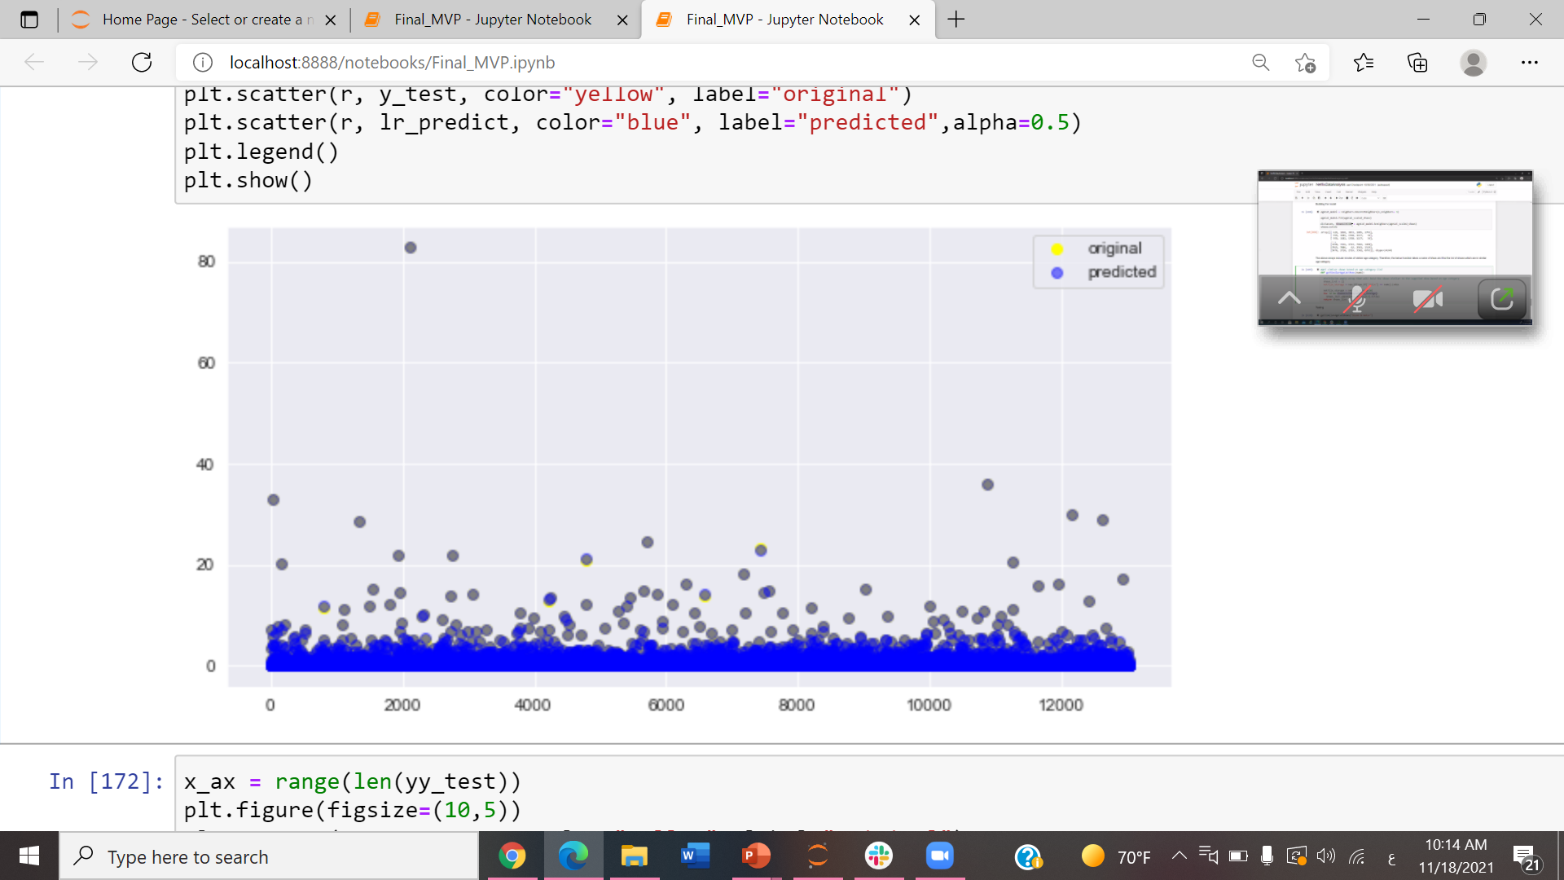
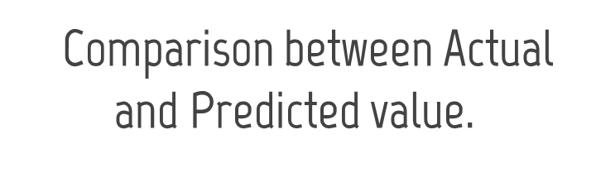
LinearRegression
RandomForest
Comparison between Actual & Predict value

Slide 9
Conclusion
Global, North American, European an Other countries sales (Except Japan),
have strong correlated.
Action genre is the highest sale in each country.
The most publisher in global is Nintendo.
DS platform is having highest values.
Global has higher sales over the years for video games and the lowest sales is Japan.
LinearRegression it give a better result more then RandomForestRegression.

